Slide 1

CARE ME
Premium Care
Personal Touch!
Nitin Salvankar
Sunand Pujari
Ushawini Vinnakota
Notes:
To use this title animation slide with a new image simply 1) move the top semi-transparent shape to the side, 2) delete placeholder image, 3) click on the picture icon to add a new picture, 4) Move semi-transparent shape back to original position, 5) Update text on slide.

Slide 2
INTRODUCTION
Goal:
Help people take care of their health in a personalized way
ADVANCED MOBILE APPLICATION DEVELOPMENT: Semester Project
Problem statement
Build an app in android using ResearchStack framework

Slide 3
DESIGN GOALS
Design Goals and Design Justification
Utility
Easy to use.
Memorability
Intuitive Design.
Learnability
Minimizing the number of steps within the model by giving the user access to the most pertinent parameters of the interface.
Safety
Integrity of Information as it consists of sensitive data.
Effectiveness
Clarity about the process.(The user should agree to share information.)

Slide 4
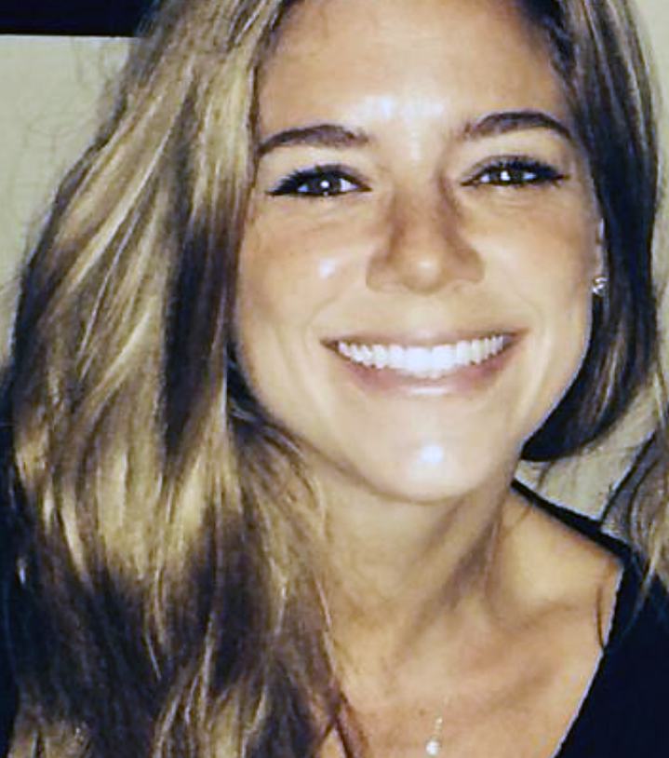





PERSONA 1
Jane Brown 32-year-old female, Married, News Reporter
Jane Brown is a health conscious woman.
She likes to check her health condition regularly.
However, her busy schedule does not allow her to do that.
She is looking for a solution where she can check her BMI, BAC , weight and other health indicators on the go.
Also, she is open to taking part in surveys. The Care Me app will aid Jane by fulfilling her needs.
User Journey
Respond messages
User logged in
Submits survey/s
Go to Dashboard for messages from coordinators
Take surveys
Calculates health parameters like BMI, BAC

Slide 5
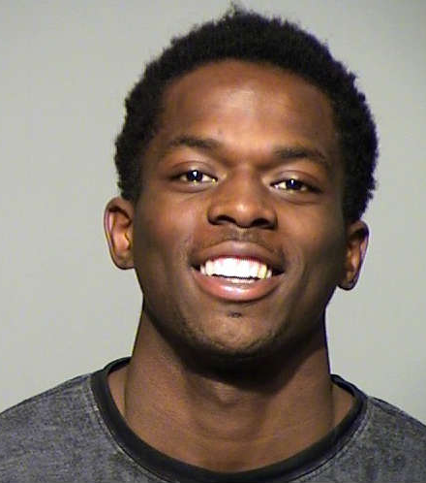
PERSONA 2
Alex Smith 28-year-old male, single, Study Coordinator
Alex Smith is a study coordinator who works for Halo Smart Labs.
The company develops solution related to health.
He needs to conduct surveys to gather data in order to build better solutions.
The Care Me mobile app will help him to gather that data.
He can conduct surveys on a variety of topics.
He can tap in users’ responses and analyze them to identify the patterns in the responses.
User Journey
Broadcast to applicable participants
Study survey responses
Login to server
Create a study
Broadcast general messages

Slide 6
DESIGN CONCEPT

Slide 7
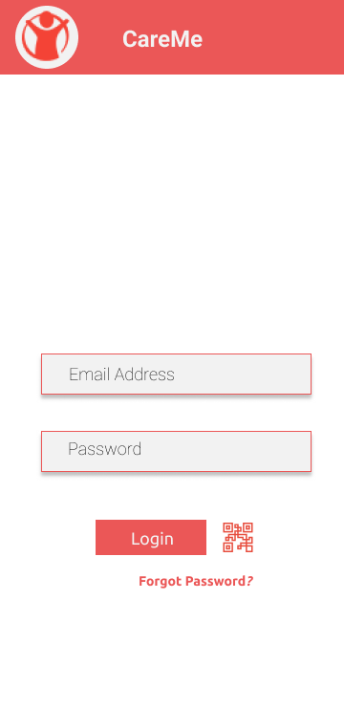
1
Bar code to let users login and be a part of the study.

Slide 8
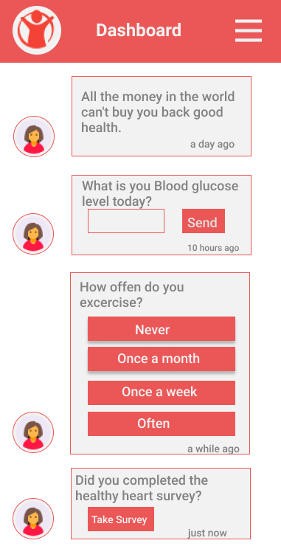
2
A Dashboard for the survey questions.

Slide 9
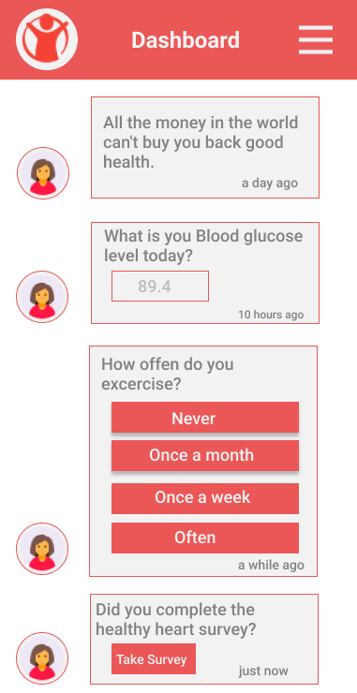
3
3 Message types:
A general message about health.
A Yes/No response question.
A message with response in range.

Slide 10
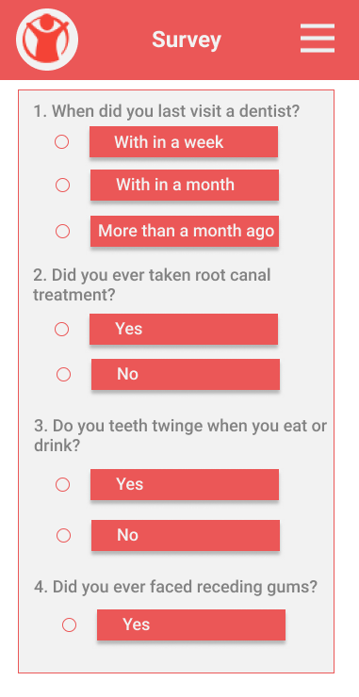
4
The study co-Ordinator will create a survey to gather information on various health topics.

Slide 11
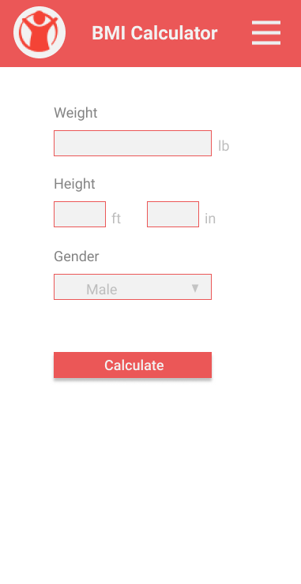
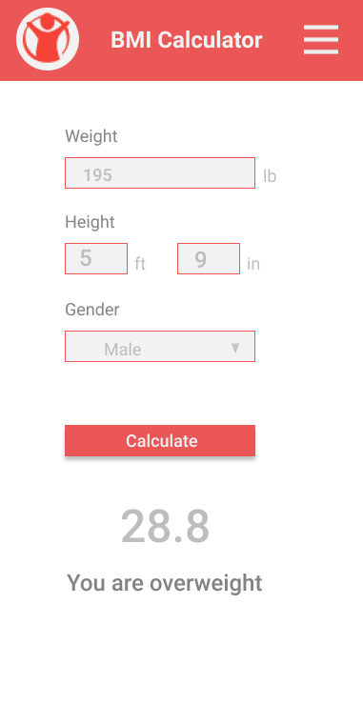
5
The user can use the BMI Calculator by clicking on a button provided in the messages on the Dashboard.

Slide 12
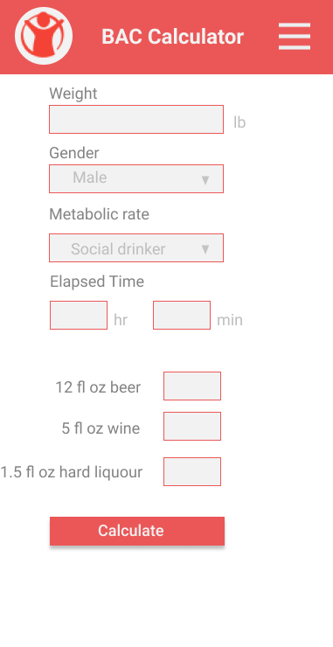
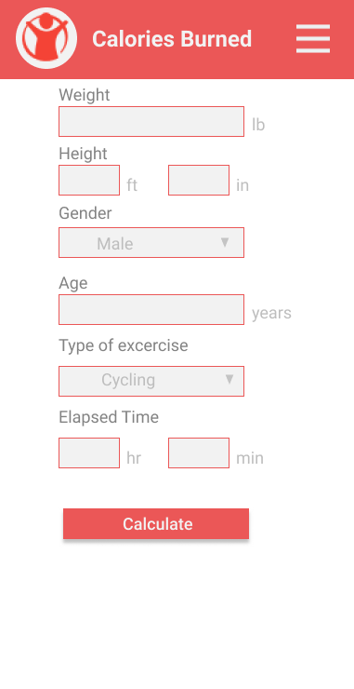
6
Similar to the BMI Calculator, the user will get other means to know about his/her health.

Slide 13
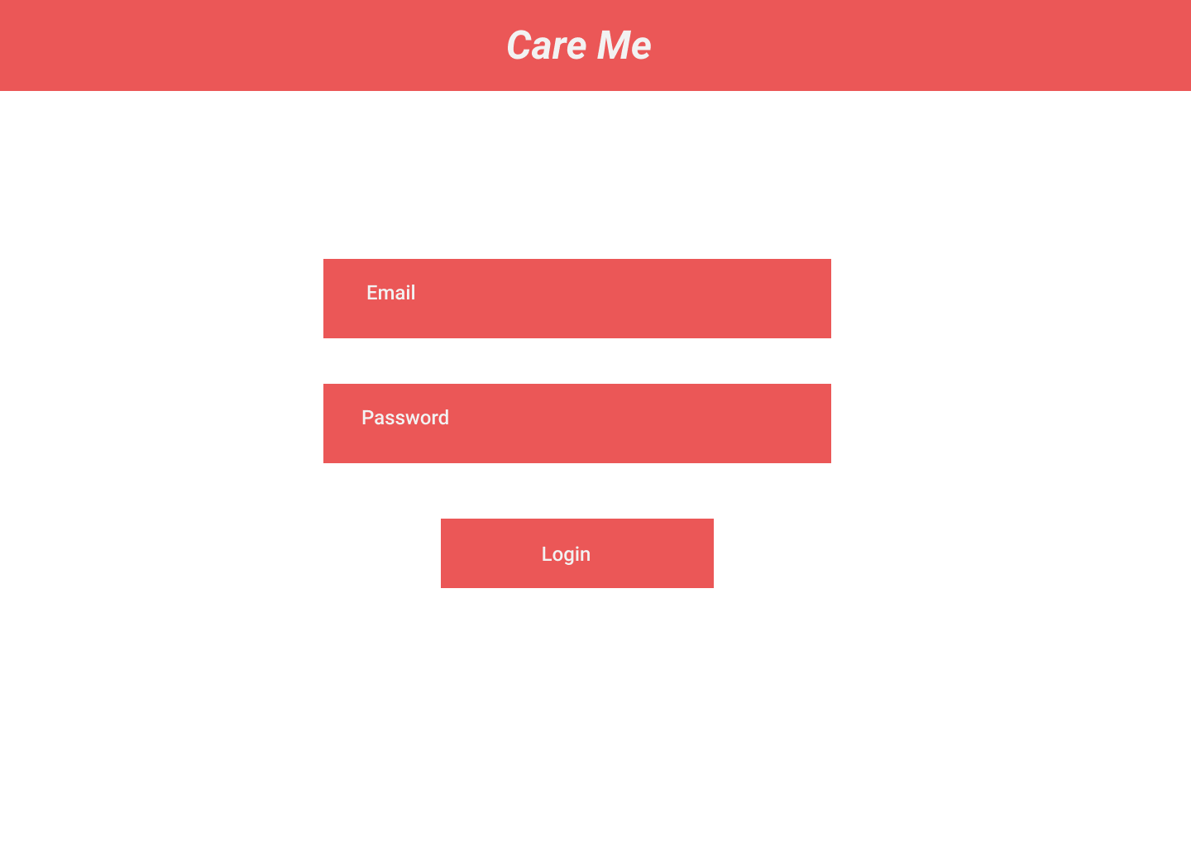
7
Web App Login Screen.

Slide 14
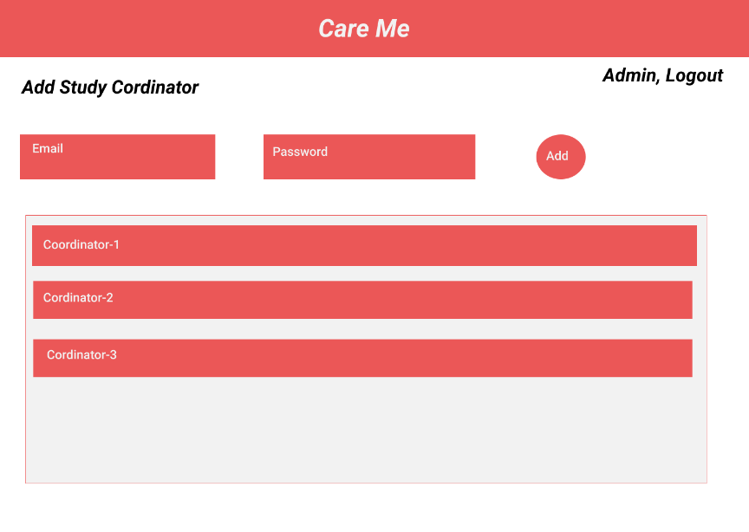
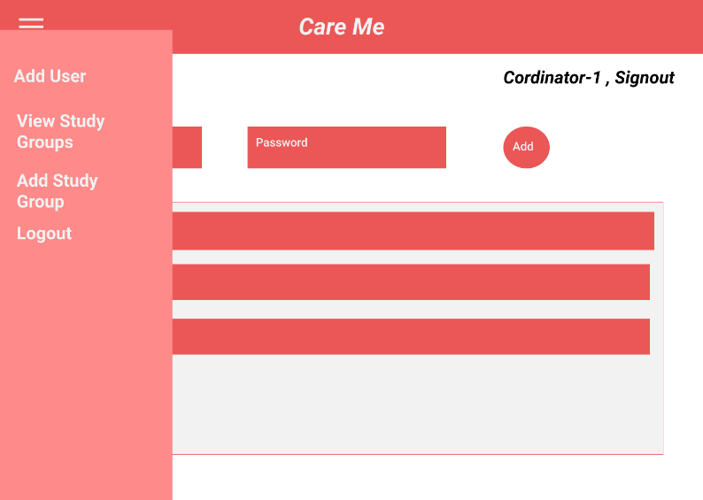
8
Initial Screen of Admin where he can add Study coordinator
9
Initial Screen of Study Coordinator and his various options

Slide 15
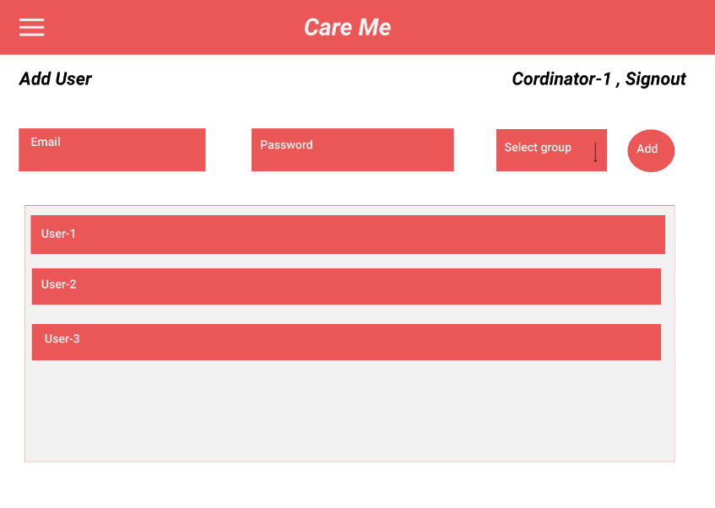
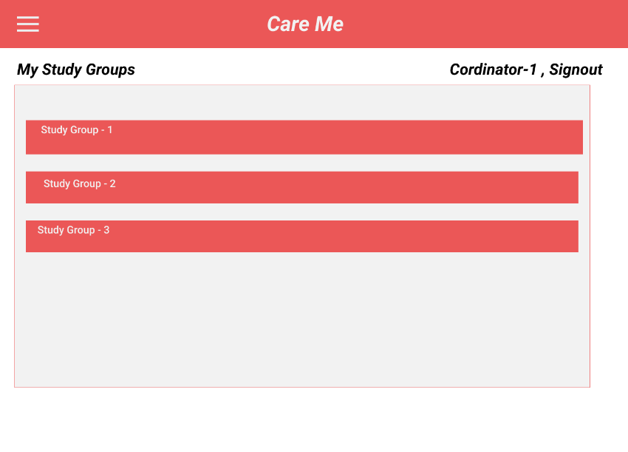
10
Coordinator to add user to study
11
List of study groups under study coordinator

Slide 16
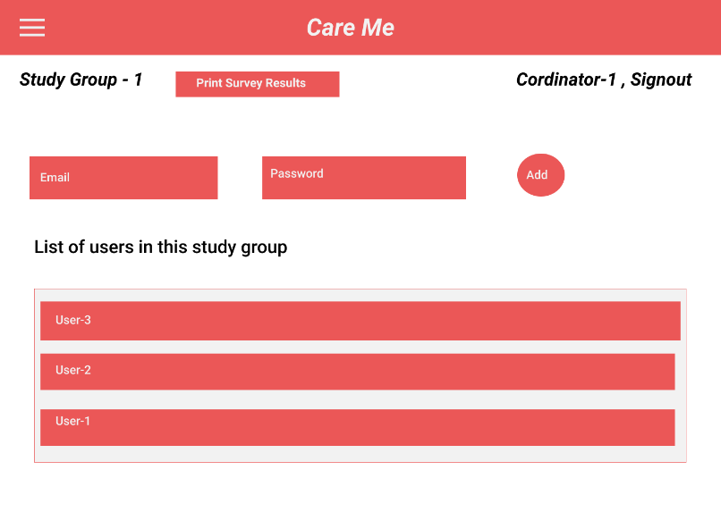
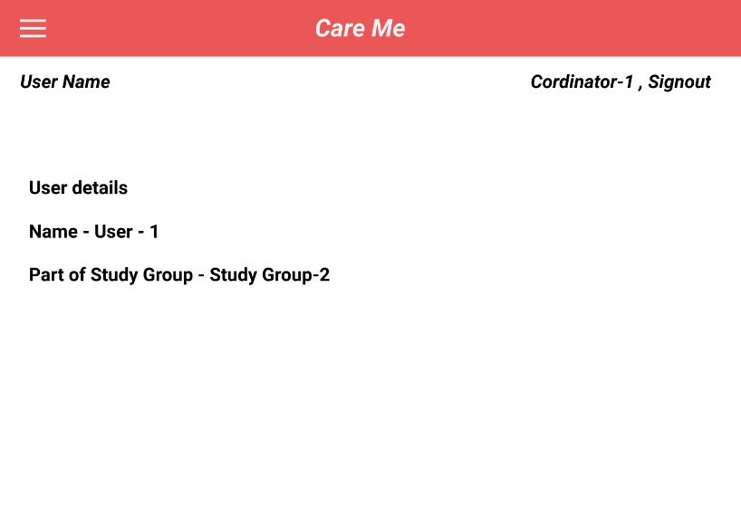
12
Coordinator on clicking a row in list – shows particular study. Can print results and view users under group
13
Coordinator clicking on a particular user opens profile

Slide 17
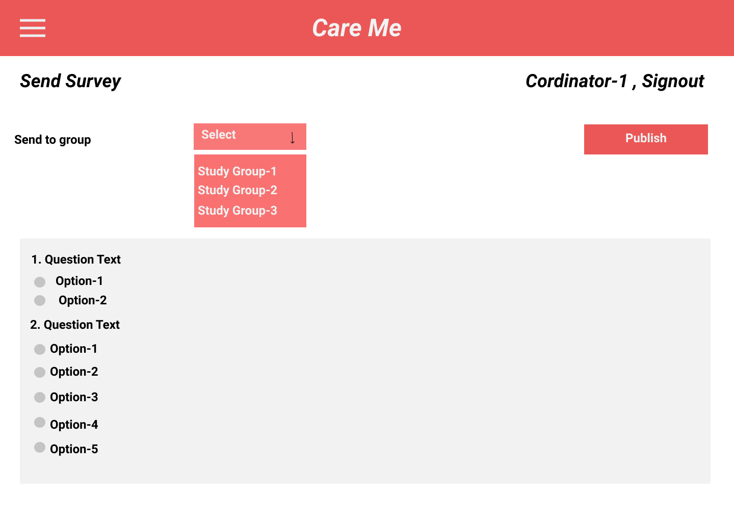
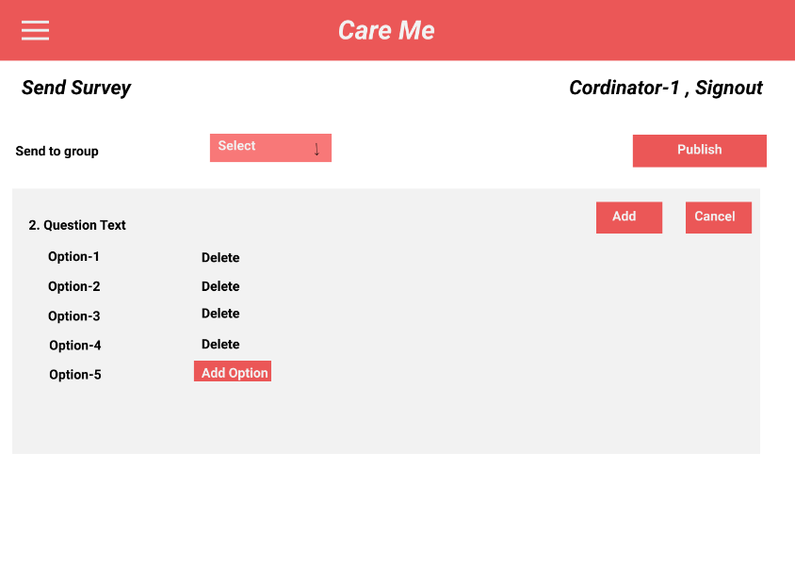
14
Coordinator on selecting Send Survey from side bar
15
Preparing questions

Slide 18
INTERACTION MODEL
User Action
User scans the barcode
User goes to the Dashboard
User responds to a question
User clicks on “Take a Survey”
User submits the survey
User clicks on “Use BMI Calculator”
User clicks on Calculate in BMI Calculator
Device Response
User is logged into the app.
User receives all the messages sent to him.
The response is captured and sent to the server. The message vanishes from the screen of the user.
Th survey window is opened withal the survey questions.
The survey response of the user is sent to the server.
A BMI calculator is opened up for the user to use.
The calculation of BMI is shown w.r.t the values entered by the user.

Slide 19
THANK YOU

